Slide 1


AI Based DoS Detection for SOC
Presented by Hen Golyan & Noga Menahem

Slide 2
The Problem
DoS attacks can disrupt the availability of network services.
SOC analysts need to detect attacks quickly while minimizing false alarms.
A simple binary prediction is not enough: analysts also need context, confidence, and supporting evidence.
Goal: Support faster and more informed SOC decisions.

Slide 3
Project Goal
Build an AI assisted SOC pipeline that can:
Detect Normal vs. DoS network traffic
Compare supervised and anomaly detection approaches
Generate a DoS confidence score and risk level
Provide explainable evidence
Support human review and audit logging
The system does not automatically block traffic.

Slide 4
Dataset – CICIDS2017
Wednesday Working Hours dataset
Contains benign traffic and several DoS attack types
Original labels include:
BENIGN, DoS Hulk, DoS GoldenEye, DoS slowloris, DoS Slowhttptest
Final task: Normal vs. DoS

Slide 5
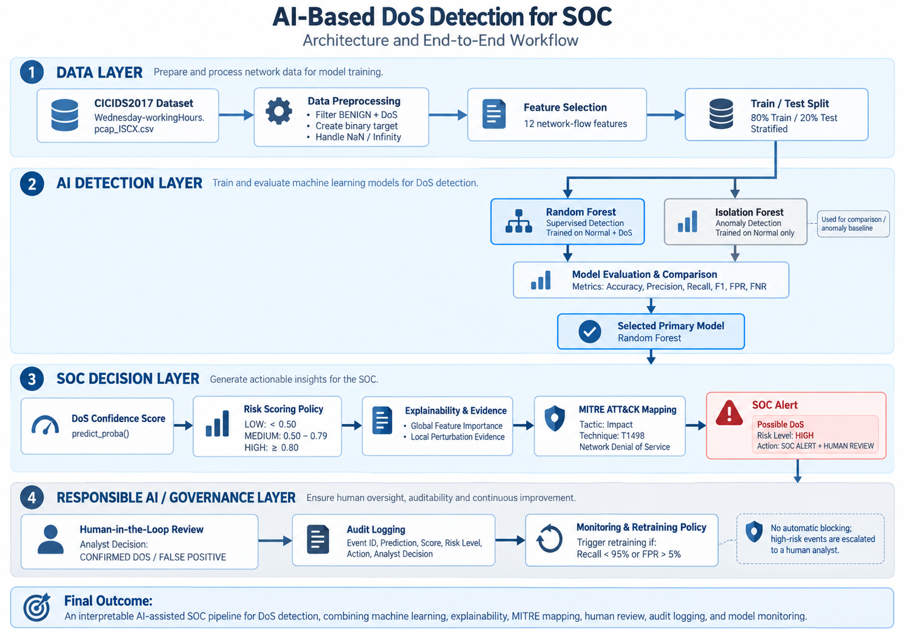
System Architecture
End-to-end pipeline from raw network traffic to SOC alert, human review, logging, and monitoring.

Slide 6
Data Preparation & Feature Selection
Preprocessing
Keep BENIGN and DoS traffic
Binary target: 0 = Normal, 1 = DoS
Handle missing and infinite values
80/20 stratified train-test split
12 Selected Network-Flow Features
Flow Duration
Packet counts and lengths
Flow Bytes/s
Flow Packets/s
SYN / ACK flags

Slide 7
Machine Learning Models
Random Forest
Supervised learning
Trained on Normal + DoS traffic
Learns known DoS patterns
Isolation Forest
Anomaly detection
Trained only on Normal traffic
Detects unusual network behaviour

Slide 8
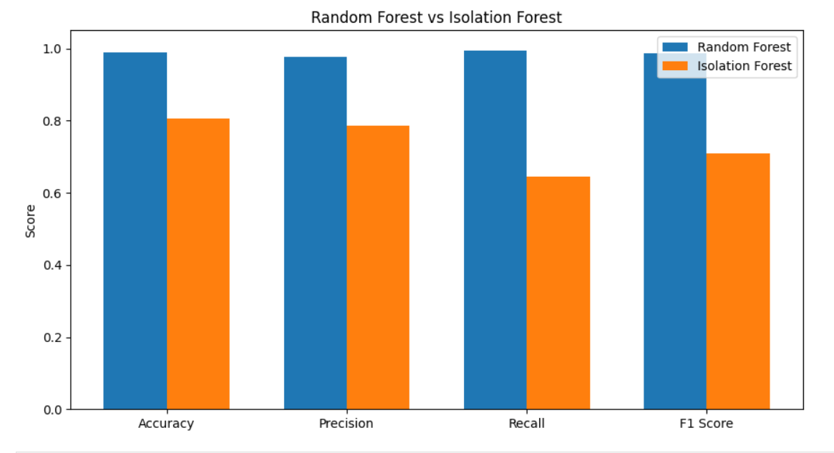
Model Performance
Random Forest
Accuracy: 98.96%
Precision: 97.73%
Recall: 99.45%
F1 Score: 98.58%
Random Forest achieved consistently stronger performance.

Slide 9
Security Relevant Error Rates
Random Forest
False Positive Rate: 1.32%
False Negative Rate: 0.55%
Isolation Forest
False Positive Rate: 10.08%
False Negative Rate: 35.50%
Random Forest missed far fewer DoS attacks and produced fewer false alarms.

Slide 10
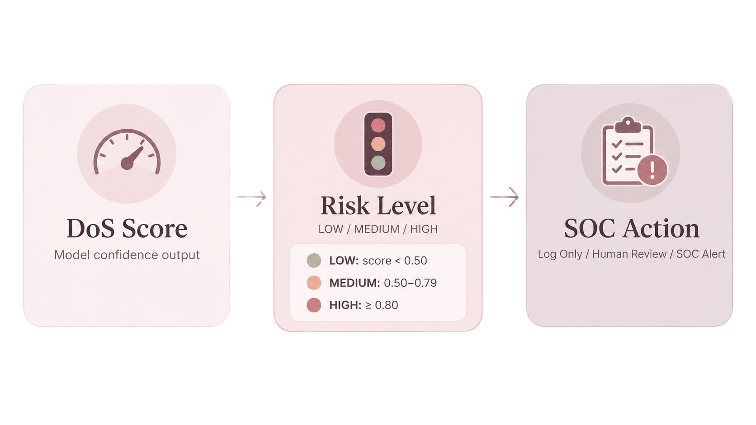
SOC Risk Scoring & Policy Gate
No automatic blocking is performed.

Slide 11
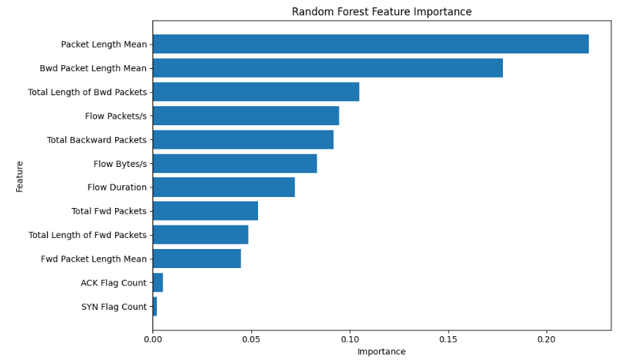
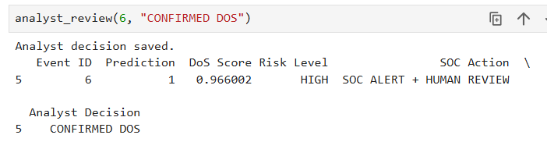
Explainability & Human in the Loop
Human Review
High-risk alerts are escalated to an analyst
Analyst can confirm DoS or mark a false positive
Global Explainability
Random Forest feature importance
Most influential features include Packet Length Mean and Bwd Packet Length Mean
AI supports the analyst,
it does not replace the analyst.

Slide 12
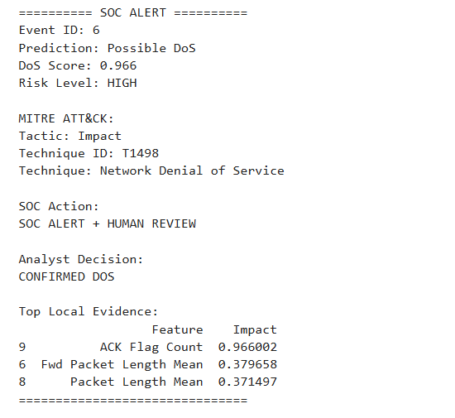
Final SOC Alert
MITRE ATT&CK
Tactic: Impact
Technique: T1498
Network Denial of Service
The final alert combines detection, risk, evidence, MITRE mapping, and analyst decision in one output.

Slide 13
Monitoring & Retraining Policy
Retraining is recommended if:
Recall < 95%
False Positive Rate > 5%
Current Random Forest Performance
Recall: 99.45%
FPR: 1.32%
MODEL PERFORMANCE STABLE
In this prototype, the policy is demonstrated using test-set performance.

Slide 14
Conclusion
Random Forest achieved the best results for the selected DoS detection task
The final pipeline goes beyond classification by adding risk scoring and explainability
MITRE ATT&CK provides standardized security context
Human-in-the-Loop prevents fully automated security decisions
Audit logging and monitoring improve traceability and future maintainability
AI assisted detection can support faster, more explainable, and more responsible SOC decision making.

